Slide 1
Bitcoin price prediction using ML
RISHAV RAJ SINGH (2000271540044)
RAUSHAN KUMAR (2000271540043)
GAURAV SINGH
(2100271549002)
ADITYA KUMAR
(2000271540007)

Slide 2
TABLE OF CONTENTS
01 | INTRODUCTION
02 | PROBLEM OBJECTIVE
03 | CRYPTOCURRENCIES VISUALIZATION
04 | LITERATURE REVIEW
05 | REQUIREMENT PLATFORM AND TOOLS
06 | ALGORITHM USED
07 | METHODOLOGY
08 | IMPLEMENTATION
09 | RESULT AND EVALUATION
10 | DEMONSTRATION
11 | CONCLUSION
12 | DISCUSSION

Slide 3



01
INTRODUCTION
Cryptocurrency Emergence:
Digital or virtual currency utilizing cryptography for security.
Operates on decentralized networks, immune to central authority control.
Bitcoin's Prominence:
Pioneer in cryptocurrency with significant market capitalization and trading volume.
Notable for its volatility, offering both challenges and opportunities for investors.
Research Focus:
Forecasting Bitcoin prices using advanced machine learning algorithms:
LSTM, ARIMAX, XGBOOST & Facebook Prophet.
Importance of Prediction Models:
Accurate predictions can lead to better investment strategies.
Helps in understanding market dynamics and potential future trends.
Innovative Approach:
Combines historical data with sophisticated machine learning techniques.
Utilizes real-time data integration for up-to-date predictions.
Potential Impact:
Provides a tool for investors to make informed decisions.
Enhances financial planning and portfolio management.
Contributes to the growing field of financial technology (FinTech).

Slide 4
02
PROBLEM OBJECTIVE
To propose a Machine Learning based model for day-to-day price prediction of bitcoin using historical data.
To predict the forecast price of bitcoin for investors and common people with upper and lower limit price limit so the risk of loss will be reduced.
OBJECTIVE

Slide 5
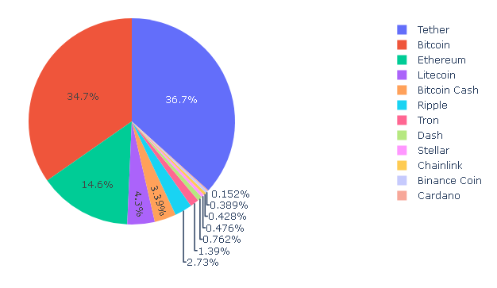
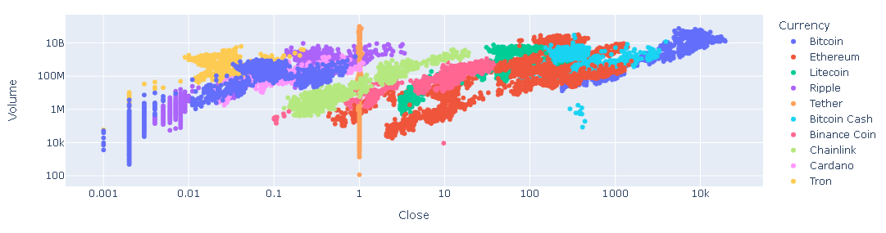
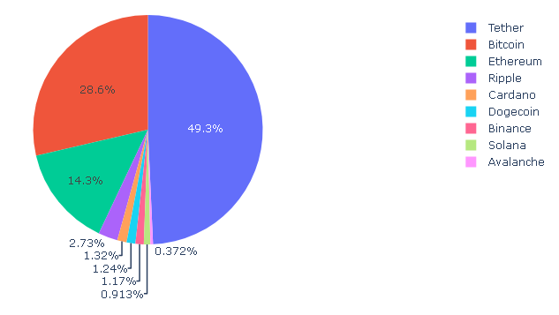
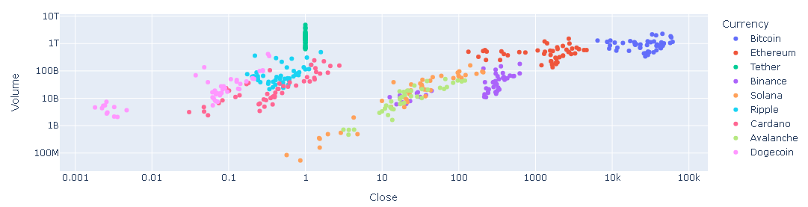
03
CRYPTOCURRENCIES VISUALIZATION
The COVID-19 has changed the dynamics of the investors related to investment and trading and the people move their traditional portfolio to cryptocurrency. After the growth of interest of common people towards investment in different field rather than only in Stock and gold market. To do so we have used following graph, plot, chart :
Pie Chart: Demonstrate the dominant market share held by Bitcoin and Tether, while scatter plots reveal the significant impact of COVID-19 on Bitcoin’s price and trading volume, with a marked increase post-2020.
Scatter plot: Scatterplots are useful for identifying correlations and trends between variables, making them a valuable tool in data analysis.

Slide 6
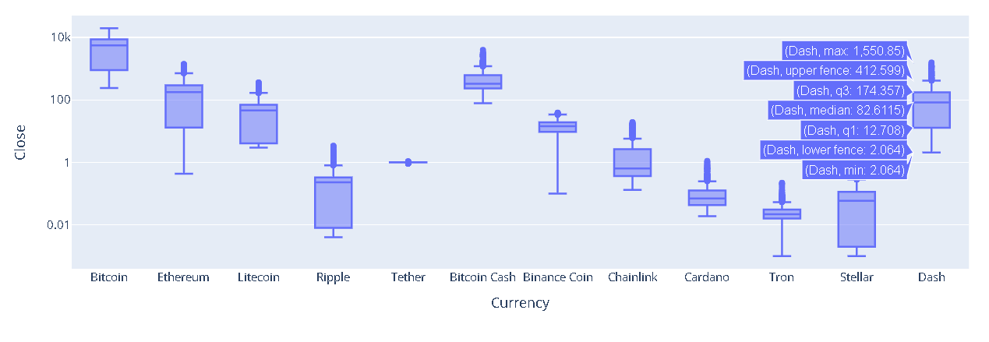
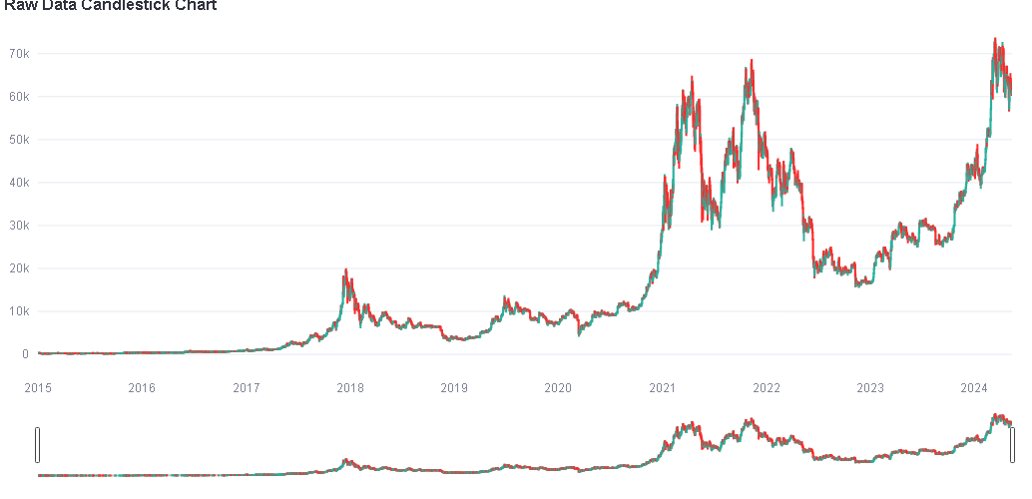
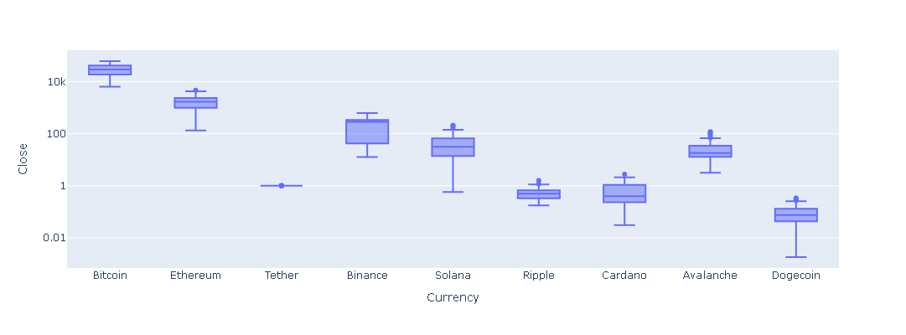
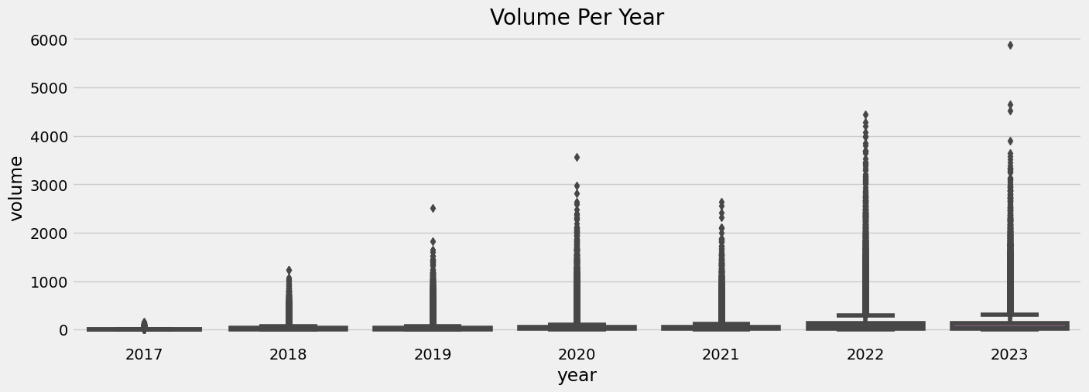
03
CRYPTOCURRENCIES VISUALIZATION
Box plot: Offer a detailed view of the distribution of trading volumes across different cryptocurrencies, showcasing the variability and outliers within the data.
Candlestick chart: Provide insights into the price action of cryptocurrencies over time, with color-coded candles indicating market trends and potential reversals.

Slide 7
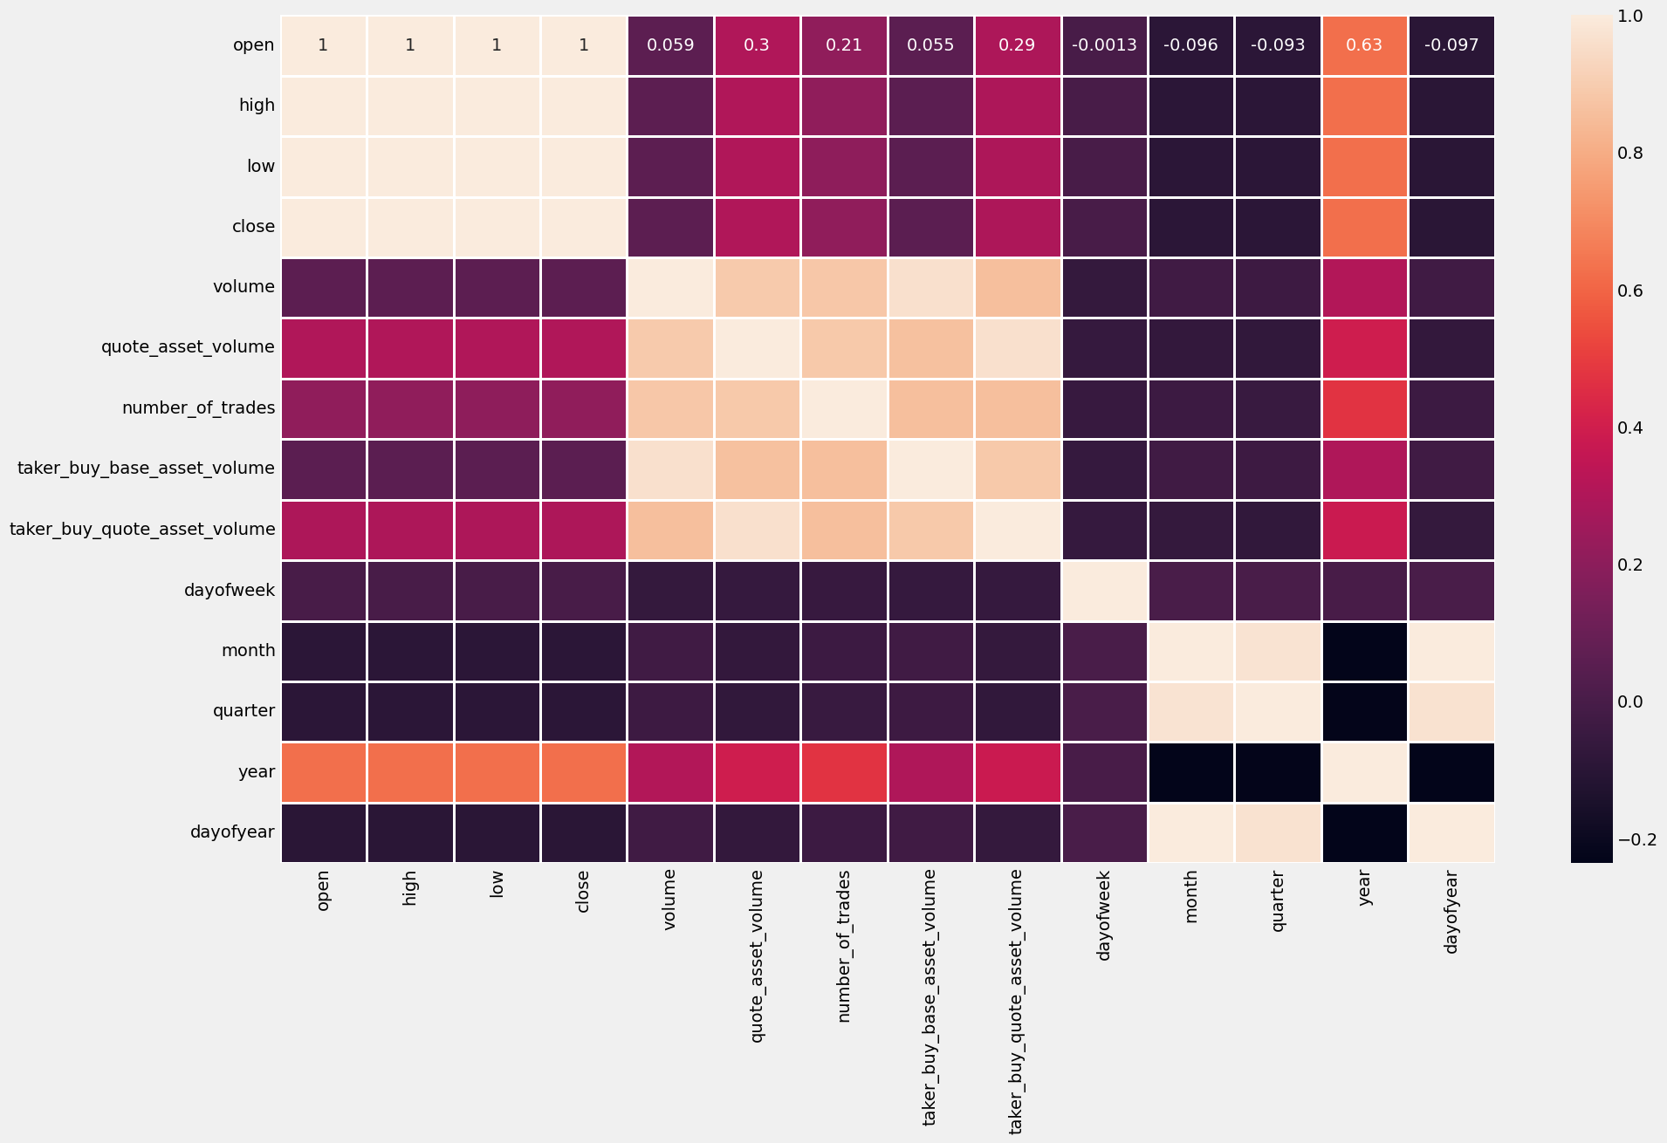
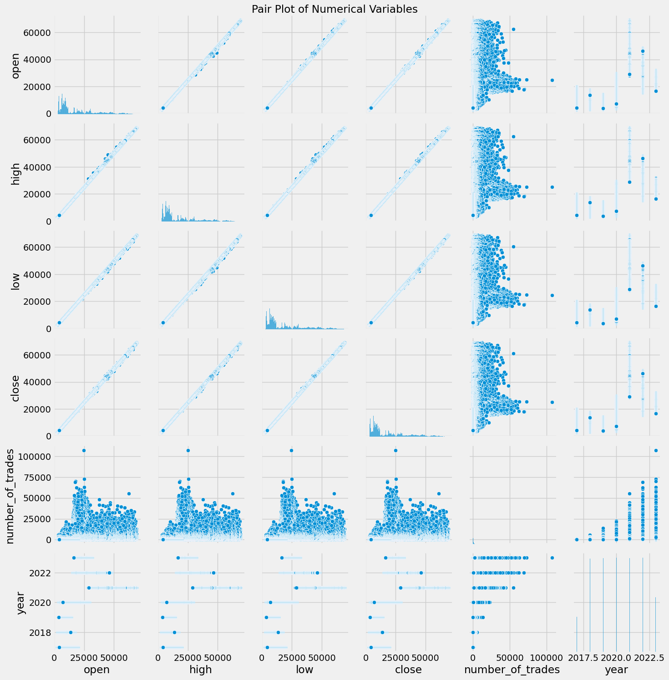
03
CRYPTOCURRENCIES VISUALIZATION
Heat Map: Illustrate the correlation between various trading metrics, such as opening and closing prices, which is crucial for understanding market behavior and developing trading strategies.
Pair plot: Allow for the examination of relationships between multiple trading metrics, aiding in the identification of trends and correlations that inform trading decisions.

Slide 8
04
LITREATURE REVIEW
AUTHOR NAME | YEAR | OBJECTIVE | ADVANTAGE | LIMITATION
Junwei Chen | 2023 | Analyzing and evaluating the effectiveness of machine learning techniques in predicting Bitcoin prices. | Comprehensive model comparison; enhanced robustness with multiple financial indicators. | Volatility and unpredictability of Bitcoin; may not generalize to future markets.
Harsh Parikh, Nisarg Panchal, Ankit Sharma | 2023 | Forecasting cryptocurrency prices. | Comparative performance analysis of different models. | Predictive accuracy and data quality issues.
Sahil Sejwal, Kartik Aggarwal, Soumya Ranjan Nayak | 2023 | Time series analysis of cryptocurrency. | Superior results to ARIMA. | ARIMAX performance depends on external variables.
Amirzadeh, Rasoul, Asef Nazari, Dhananjay Thiruvady | 2022 | Surveying AI application in cryptocurrency markets. | Processes vast datasets quickly; uncovers complex patterns. | Market volatility and limited historical data.

Slide 9
04
LITREATURE REVIEW
AUTHOR NAME | YEAR | OBJECTIVE | ADVANTAGE | LIMITATION
Linxi Pan | 2022 | Predicting cryptocurrency prices. | Insight into different model performances. | Volatility affects prediction accuracy; ARIMA struggles in high volatility.
Kanksha and Harjit Singh | 2021 | Predicting Bitcoin and Litecoin prices. | Effective for time series forecasting. | Challenges in handling extreme market fluctuations.
Khiewngamdee, C., Chanaim, S. | 2023 | Enhancing exchange rate return forecasting. | Improved forecasting accuracy with cryptocurrency data. | Complexity and volatility of cryptocurrency markets.
Hegde, Gayatri | 2023 | Predicting Bitcoin prices. | Captures complex patterns for accurate predictions. | Reliance on historical data; market volatility.

Slide 10


05
REQUIREMENT PLATFORM AND TOOLS
Google Colab
Cloud-Based:
No Installation Required: Runs in the cloud, accessible from any device.
Free GPU and TPU: Hardware acceleration for machine learning tasks.
Integration with Google Drive:
Save and Load Files: Directly save to and load from Google Drive.
Collaboration: Share notebooks easily with others.
Jupyter Notebook
Key Features:
Interactive: Combine code, text, and visualizations in one document.
Versatile: Supports various programming languages via kernels.
Extensible: Numerous extensions and plugins available.
Benefits:
Enhances learning and teaching with its interactive nature.
Facilitates data cleaning and transformation, numerical simulation, statistical modeling, data visualization, and machine learning.

Slide 11



05
REQUIREMENT PLATFORM AND TOOLS
Kaggle
Key Features:
Datasets: Access to numerous public datasets.
Competitions: Participate in machine learning competitions.
Benefits:
Enhances practical learning through competitions.
Facilitates data sharing and collaboration.
Streamlit
Overview:
Simplifies the creation of interactive web applications.
Key Features:
Fast and easy to use.
Integrates seamlessly with Python scripts.
Provides interactive widgets for enhanced user experience.
PyGwalker
Overview:
Tool for creating interactive visualizations.
Key Features:
Enhances data exploration and analysis.

Slide 12
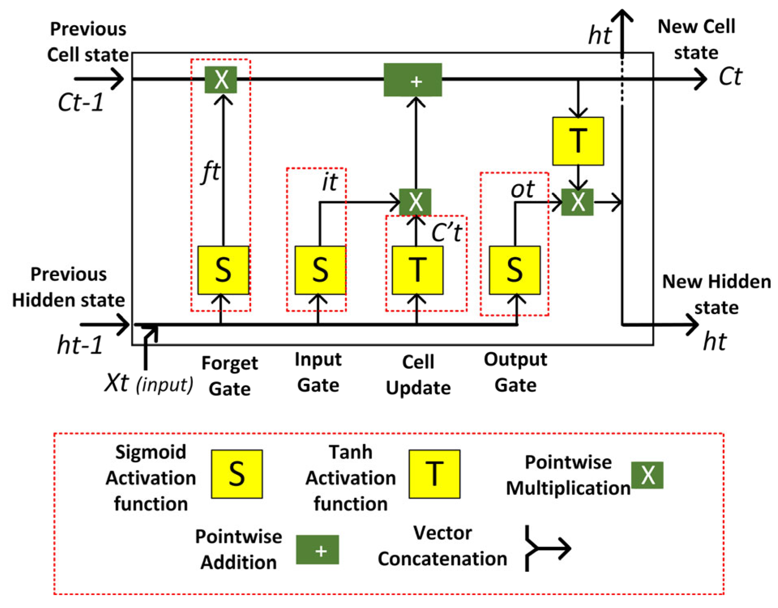
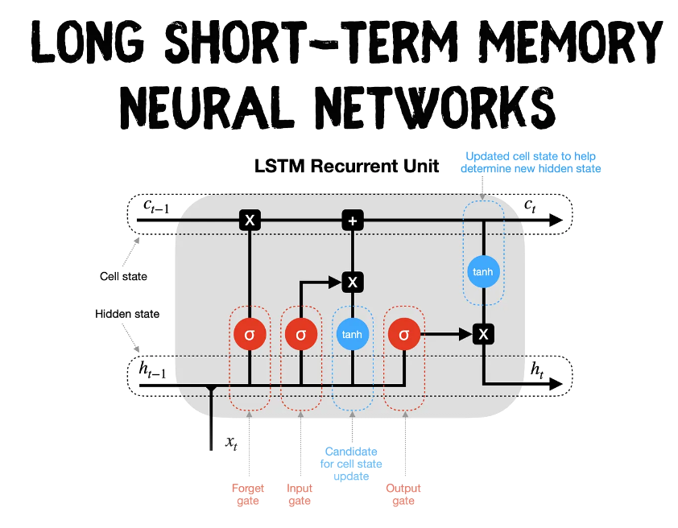
06
ALGORITHM USED
Long Short-Term Memory (LSTM)
Description:
A type of recurrent neural network (RNN) capable of learning long-term dependencies.
Regular RNNs struggle with storing information for extended periods.
Structure:
Composed of cells with gates to control the flow of information.
Application:
Effective in time series prediction, such as stock prices and Bitcoin prices.
Speech recognition, Music composition, Machine translation.
Technical Details:
Structure: Composed of cells with input, output, and forget gates to control information flow.
Key Feature: Can remember important information for long periods and forget irrelevant data.

Slide 13
06
ALGORITHM USED
Extreme Gradient Boosting (XGBOOST)
Description:
An efficient and scalable implementation of gradient boosting framework.
It is designed for speed and performance.
Features:
Regularization to prevent overfitting, parallel processing, and handling missing data.
Technical Details:
Boosting: Sequentially builds trees, where each tree corrects the errors of the previous one.
Regularization: Includes L1 (Lasso) and L2 (Ridge) regularization to prevent overfitting.
Parallel Processing: Utilizes parallel processing for faster computation.
ARIMAX
Description:
An extension of ARIMA that includes exogenous variables to account for external factors influencing the series.
Application:
Used for Bitcoin price prediction by considering market and economic factors.
Technical Details:
Components: Combines autoregressive (AR), differencing (I), and moving average (MA) components.
Exogenous Variables: Includes external variables (X) that affect the time series.

Slide 14
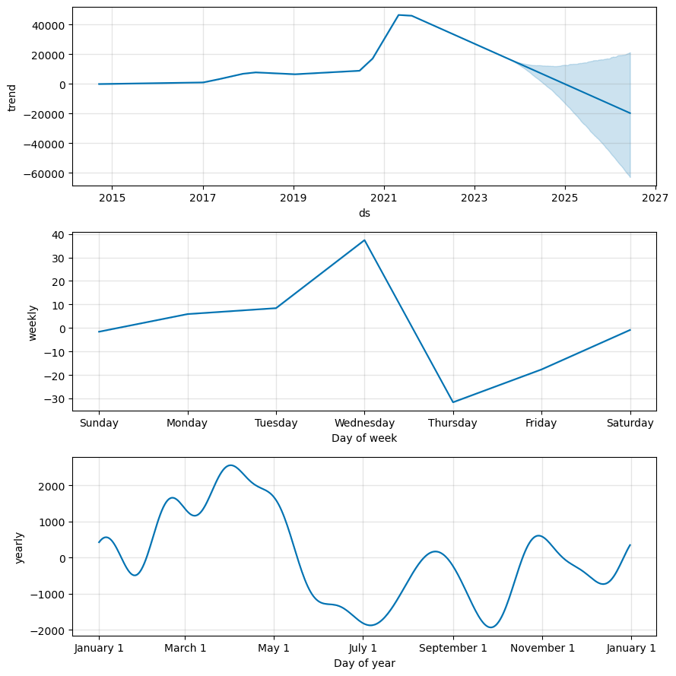
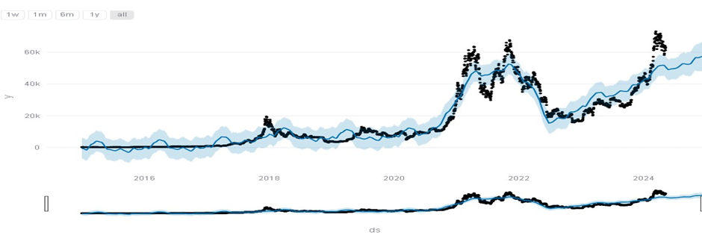
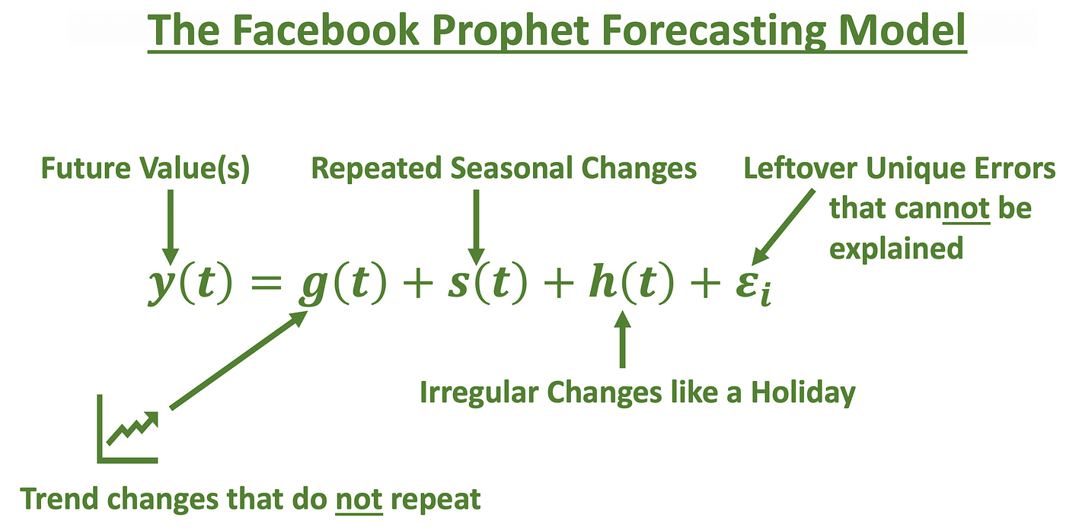
06
ALGORITHM USED
Fb Prophet
Description:
An open-source forecasting tool designed for forecasting time series data.
Features:
Handles daily, weekly, and yearly seasonality; manages holidays and missing data.
Application:
Used to forecast Bitcoin prices, capturing non-linear trends and seasonal patterns.
Technical Details:
Components: Combines trend modeling with seasonality and holiday effects.
Flexibility: Capable of fitting non-linear trends with yearly, weekly, and daily seasonality

Slide 15
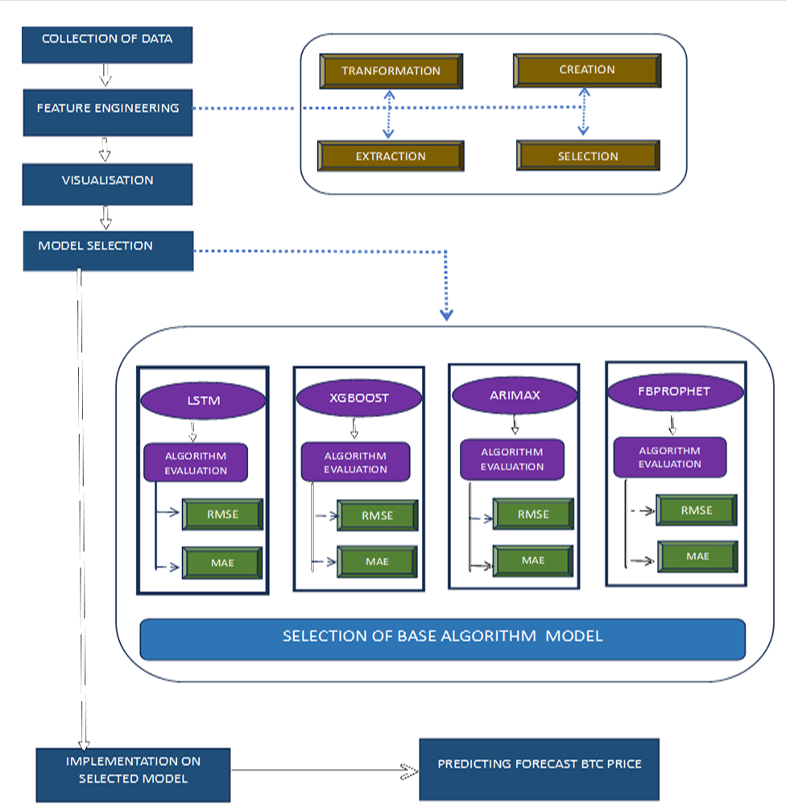
07
METHODOLOGY

Slide 16
08
IMPLEMENTATION
COLLECTION OF DATA
01
02
FEATURE ENGINEERING
VISUALIZATION
03
04
MODEL SELECTION
ALGORTIHM EVALUATION
05
06
SELECTION OF BASE ALGORITHM MODEL
IMPLEMENTATION & PREDICTION
07
08
DASHBOARD MAKING

Slide 17
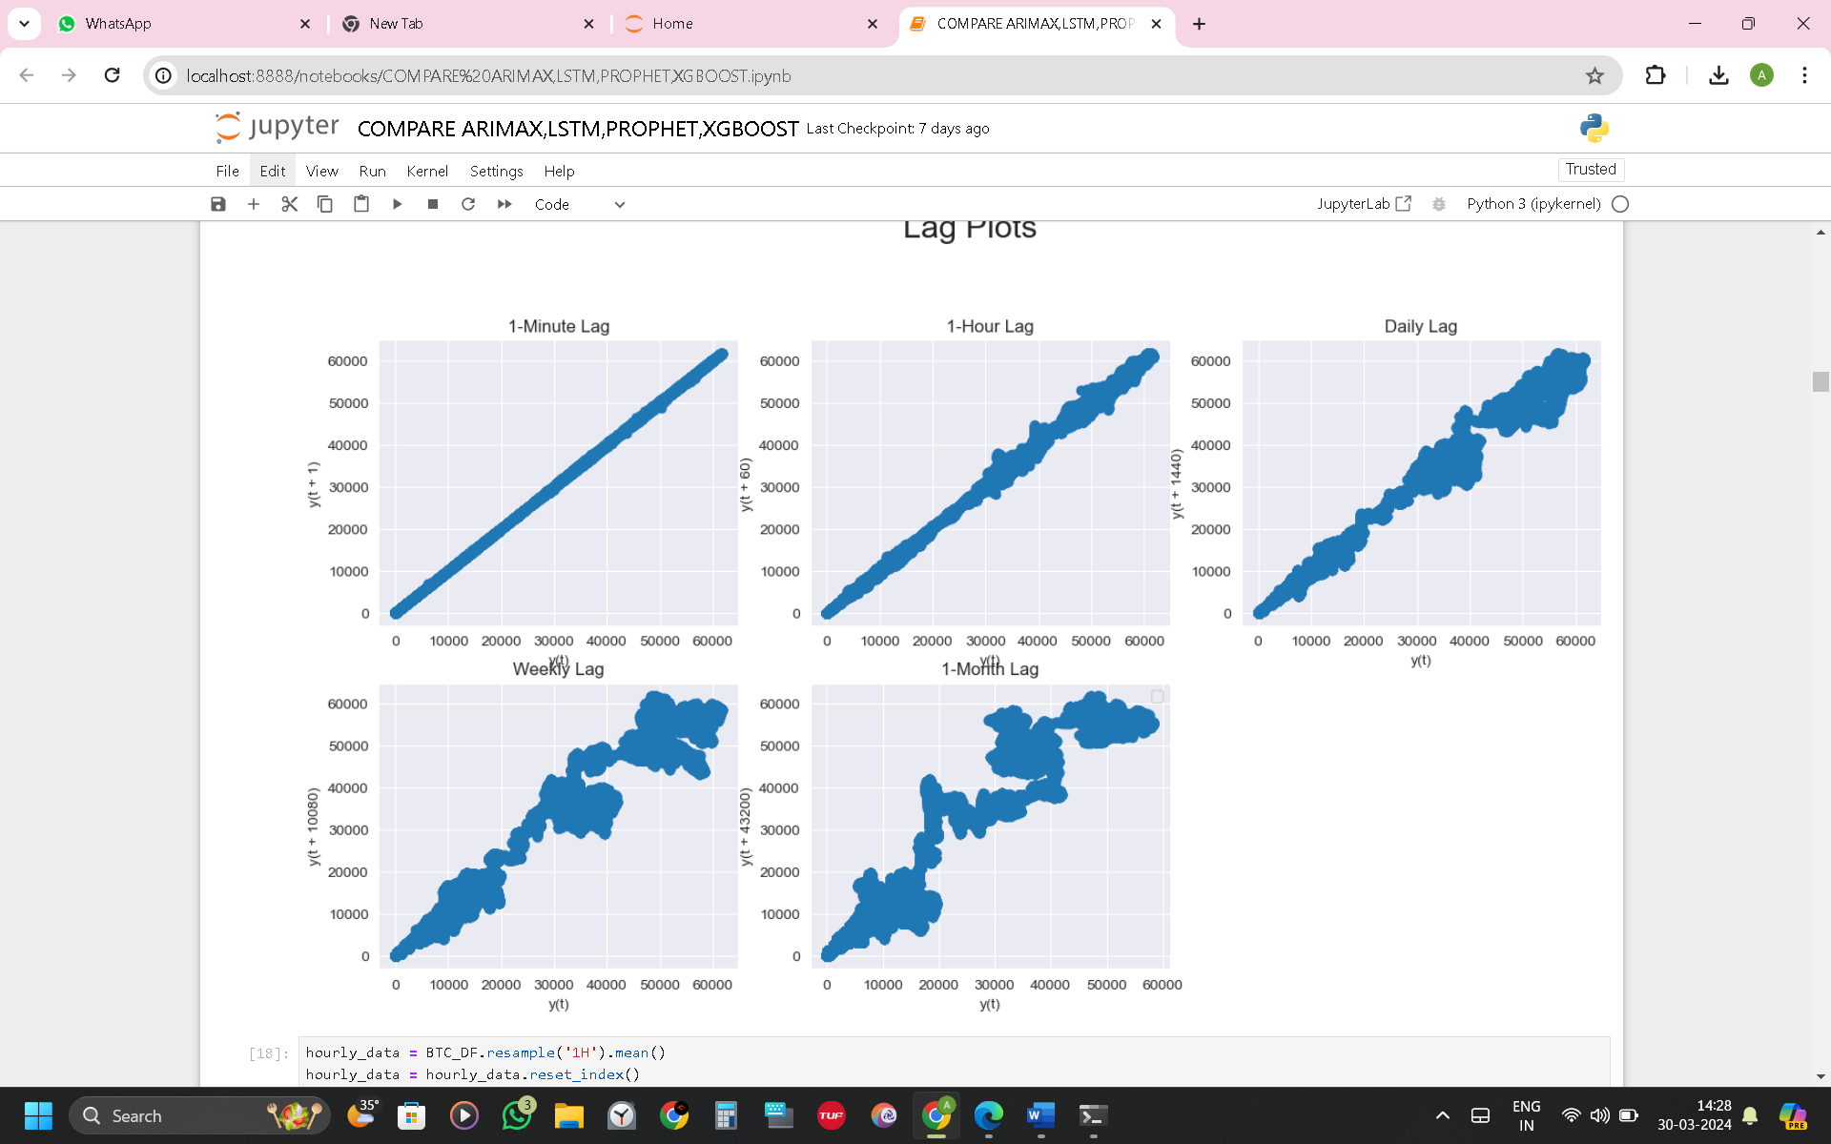
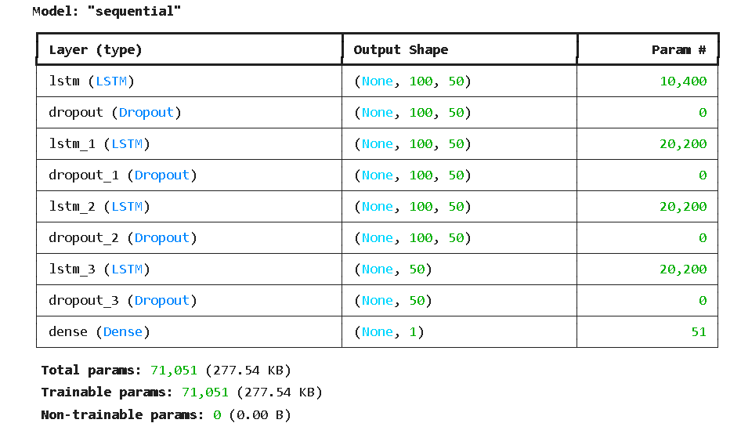
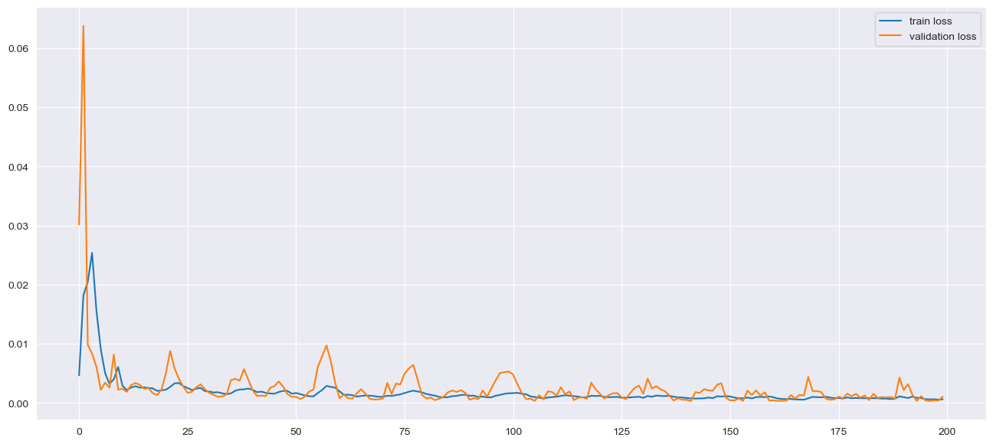
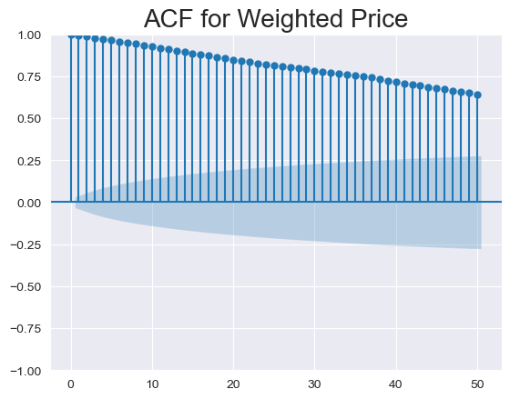
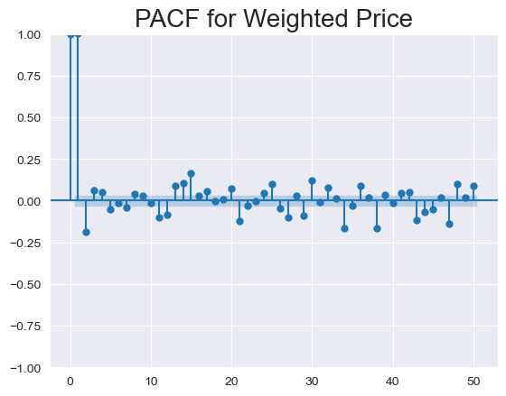
08
IMPLEMENTATION

Slide 18
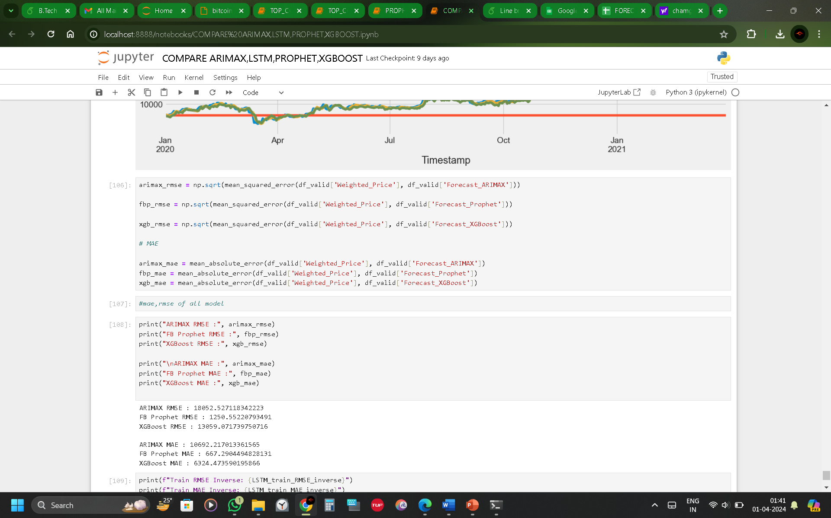
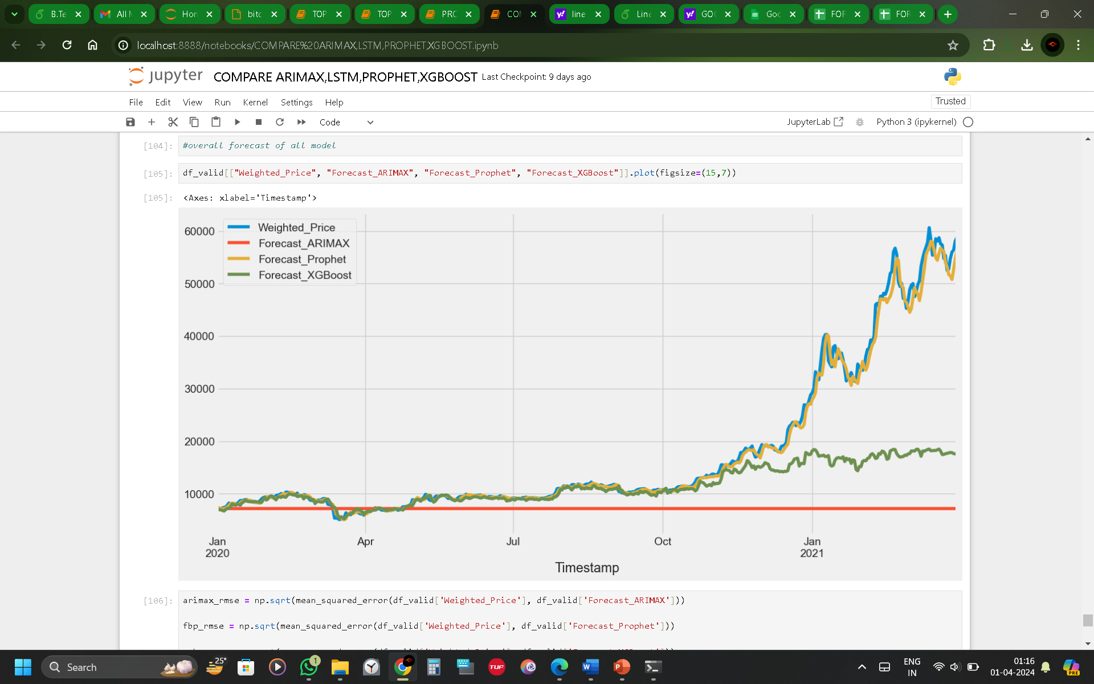
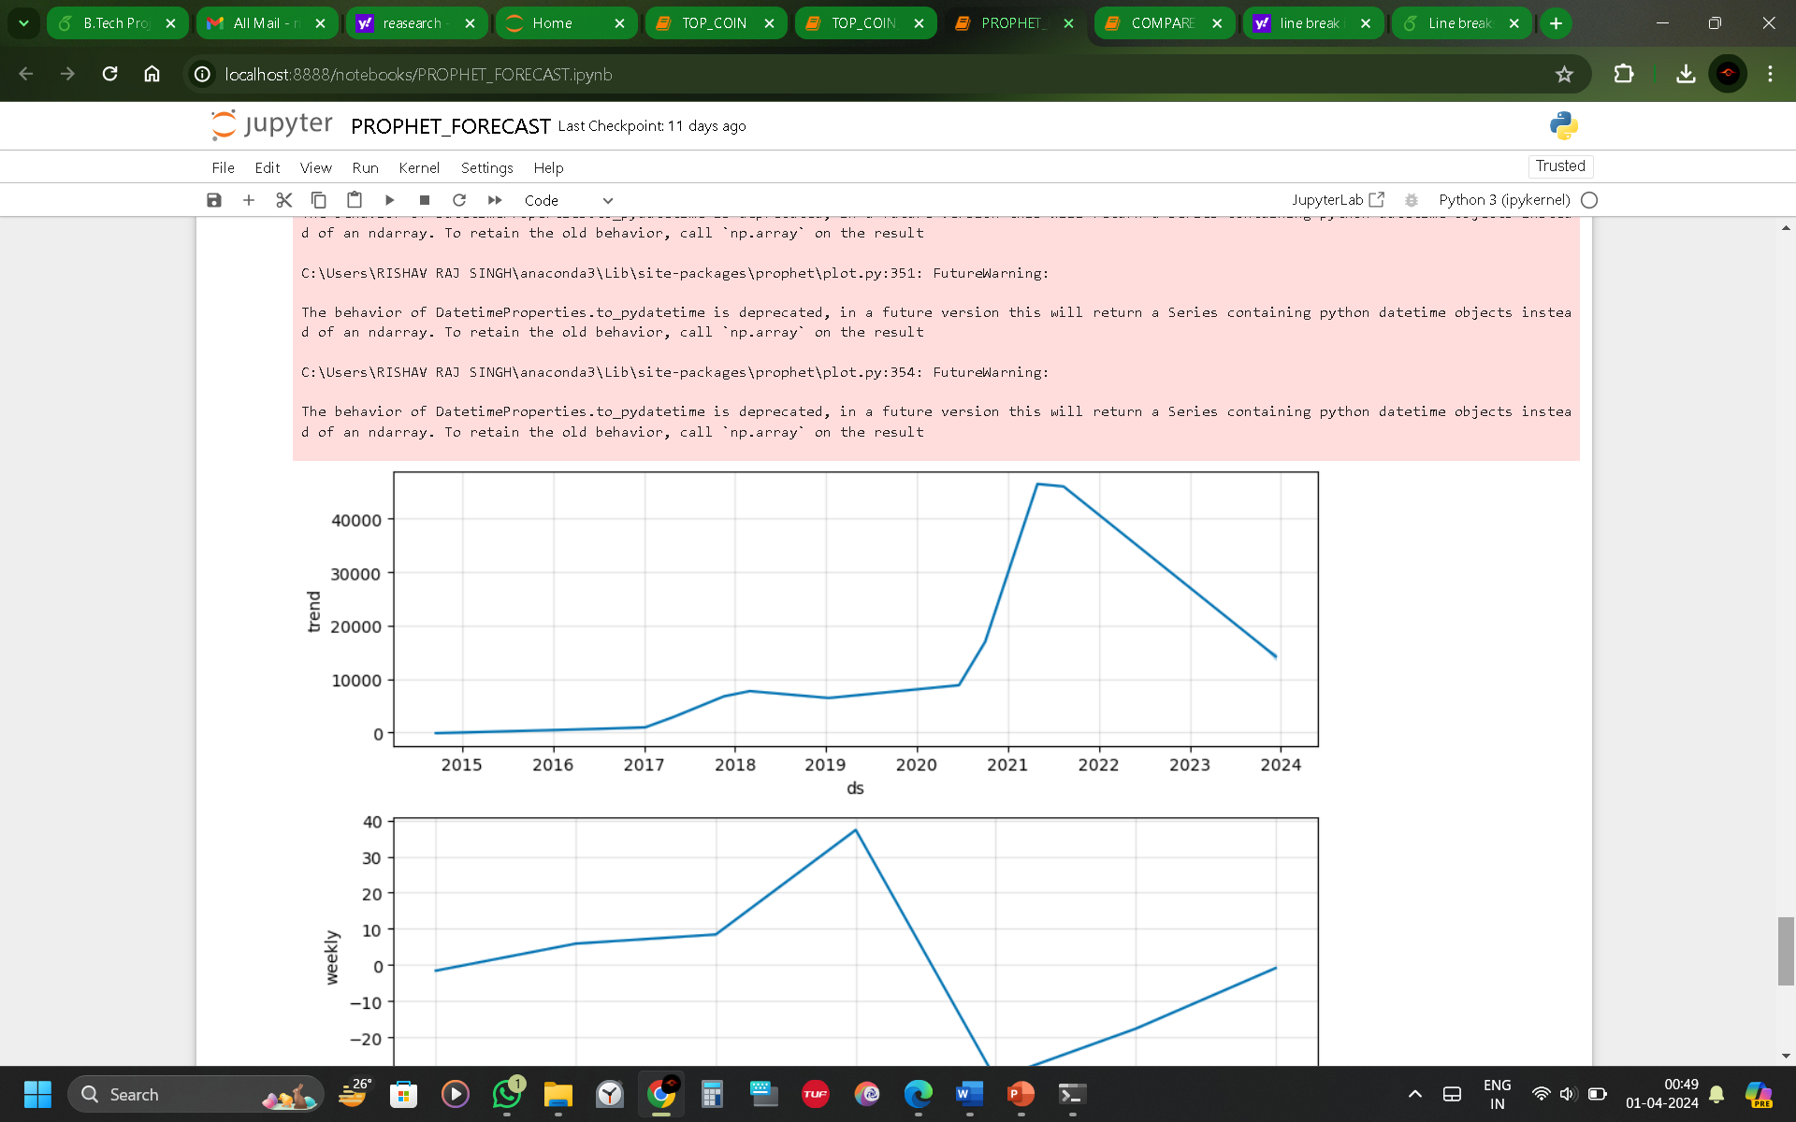
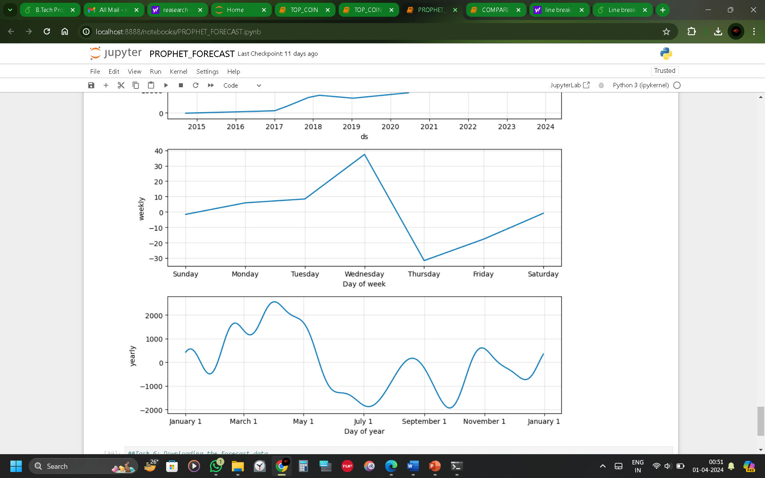
09
RESULT AND EVALUATION

Slide 19
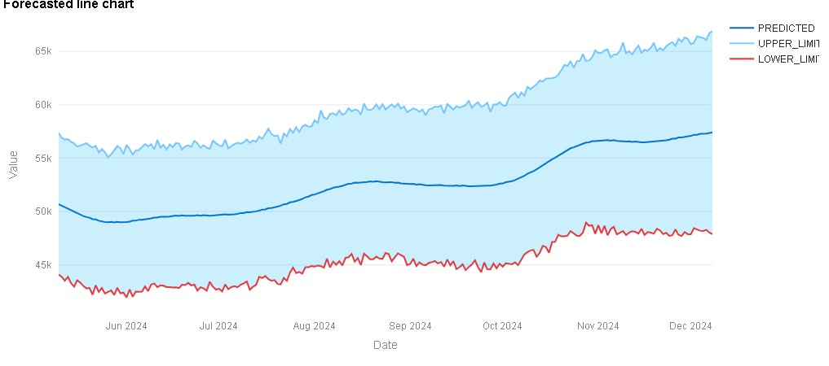
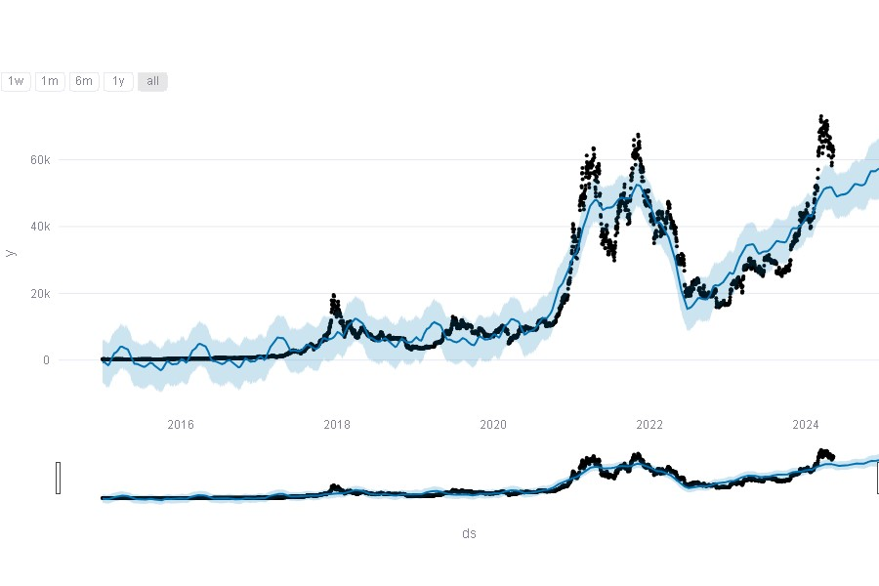
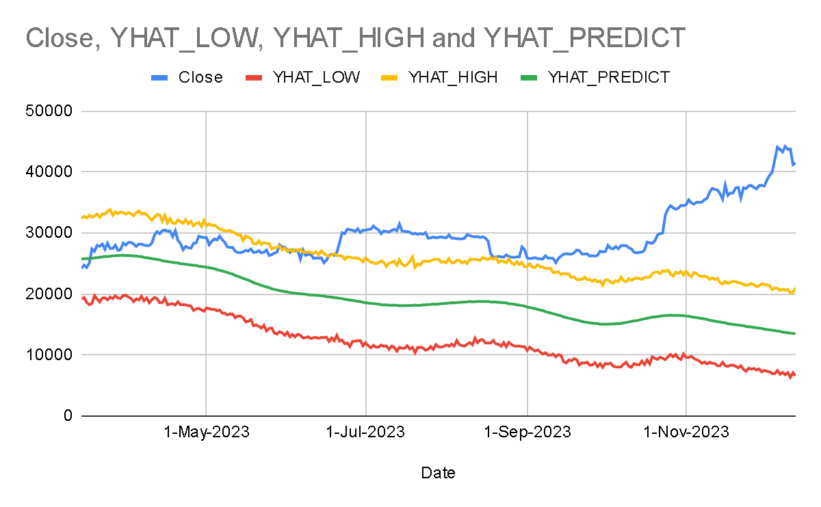
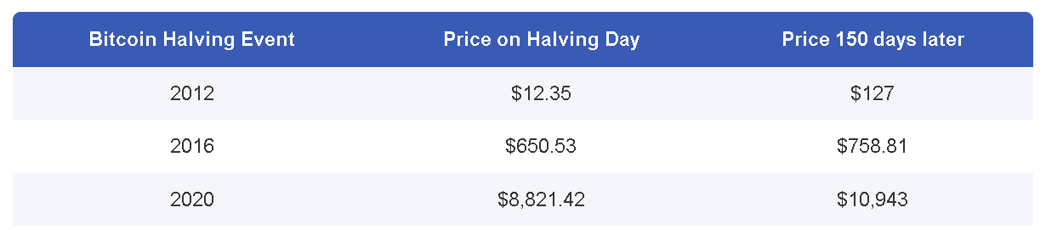
09
RESULT AND EVALUATION

Slide 20
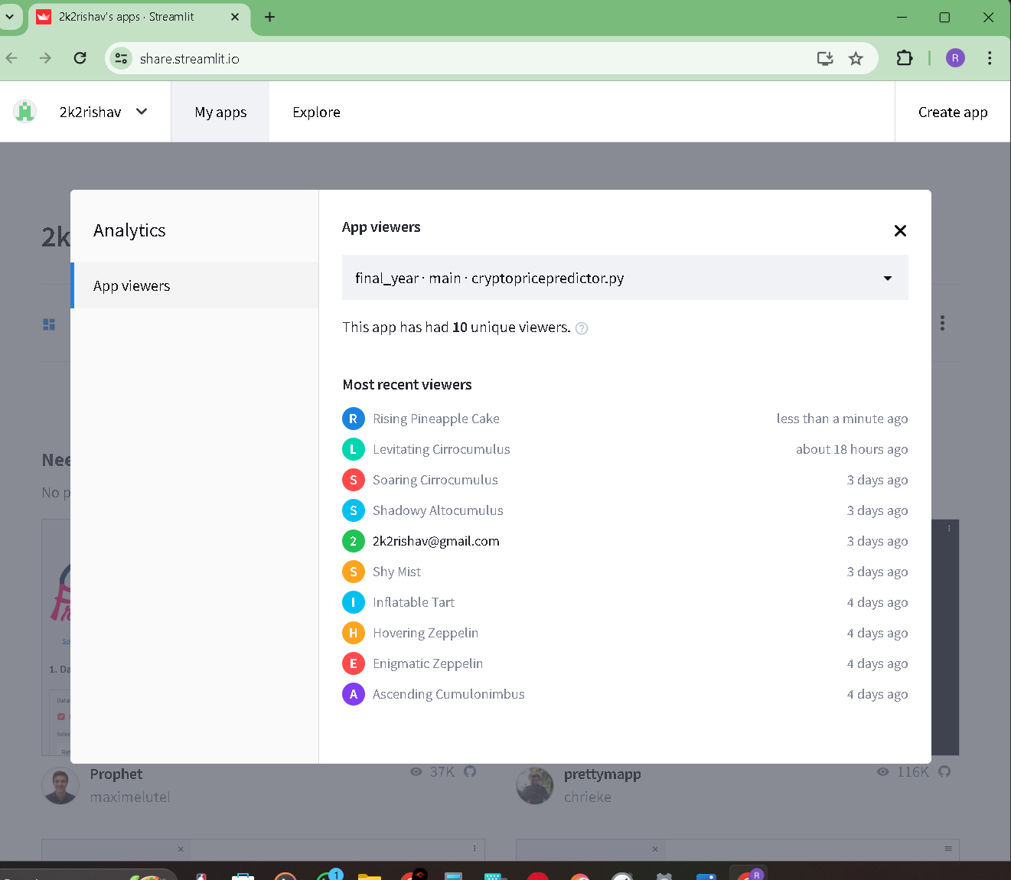
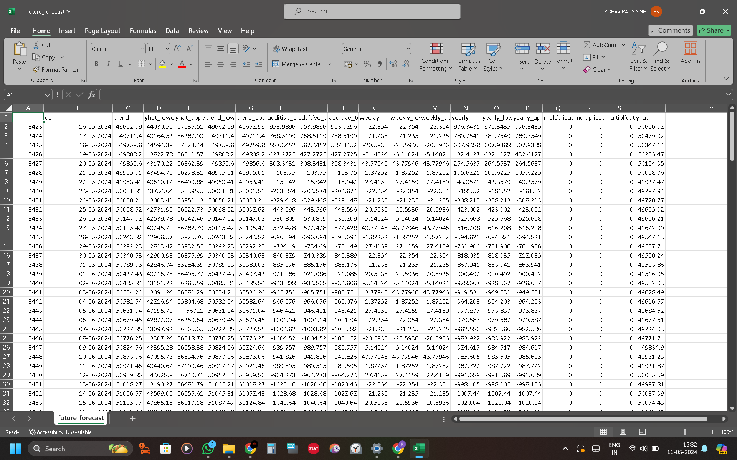
10
DEMONSTRATION
GITHUB : https://github.com/2k2rishav/final_year
WEBSITE LINK : https://crypto--price--predictor--2024.streamlit.app/

Slide 21
11
CONCLUSIONS
The primary objective of developing a predictive model for Bitcoin prices has been achieved. The model caters to diverse needs such as investment decision-making, risk management, portfolio optimization, market analysis, financial planning, cryptocurrency exchange operations, regulatory compliance, and risk assessment in trading.
This research project has not only contributed to the advancement and understanding of cryptocurrency markets in the digital era but also provided a valuable tool for stakeholders in the cryptocurrency domain.
The predictive model developed in this study can serve as a reliable guide for financial investors, aiding them in making informed decisions in the dynamic world of cryptocurrency trading.
The research’s findings underscore the potential of machine learning algorithms in forecasting Bitcoin prices and highlight the importance of continuous innovation in this rapidly evolving field.
The model’s ability to set upper and lower limits for price fluctuations is a novel approach that can aid investors in risk management and decision-making processes. This feature can mitigate the risk factor when the Bitcoin price exceeds the upper limit and prevent a sudden market crash when it exceeds the lower limit.

Slide 22
12
FUTURE SCOPE
Broaden Cryptocurrency Coverage:
Extend the predictive model to include other cryptocurrencies such as Ethereum, Ripple, and Litecoin.
Real-Time Data Integration:
Incorporate real-time data feeds for up-to-date and relevant predictions.
Analyze Impact of Global Events:
Examine global economic indicators and use Natural Language Processing (NLP) for news and sentiment analysis.
Incorporate Advanced Machine Learning Techniques:
Integrate sophisticated algorithms like deep learning models, ensemble methods, and reinforcement learning.
Develop User-Friendly Applications:
Create accessible platforms with intuitive interfaces for novice and experienced investors.
Enhance Educational Resources:
Develop content to educate users on using prediction tools and make informed decisions.
Community Engagement:
Establish a forum for users to share insights, feedback, and collaborate on improvements.

Slide 23


